Slide 1


Project - Data Manipulation and Reporting with Power BI
SUBMITTED BY: EPSA KAPUR

Slide 2
OBJECTIVE
To construct a consolidated and interactive Power BI report that will allow Zomato to quickly assess the required data.

Slide 3
Problem Statement
Zomato is a restaurant aggregation and meal delivery service based in India. It is currently operating in several countries across the world. Zomato provides thorough information about numerous eateries as well as consumer reviews. Zomato's owners aim to find hidden irregularities in their company's data.
The data (sample) is currently accessible in the form of a few Excel files, each of which contains information about multiple restaurants operating in a certain continent.

Slide 4
Motivation
The clients want to construct a consolidated and interactive Power BI report that will allow them to do the following:
• Derive data on the total number of restaurants worldwide, including continents, countries, and cities.
• View data on a global scale with the capacity to drill down to a granular level.
• Derive data on the restaurants with the highest average customer ratings.
• Discover the restaurants with the lowest average costs.

Slide 5
Motivation
• Filter and view information on the restaurants based on:
Their geographical dimensions such as continent, country, and city.
The service they provide, such as online ordering or reservation services.
The average rating slab by color.
• Identify the restaurants with the most cuisines served.
• Design a multi page report that suits Zomato's theme with easy navigation across sections.
• Allow Zomato users to be able to access this information from both a web browser and a mobile device.

Slide 6
Motivation
• Filter and view information on the restaurants based on:
Their geographical dimensions such as continent, country, and city.
The service they provide, such as online ordering or reservation services.
The average rating slab by color.
• Identify the restaurants with the most cuisines served.
• Design a multi page report that suits Zomato's theme with easy navigation across sections.
• Allow Zomato users to be able to access this information from both a web browser and a mobile device.

Slide 7
ETL STEPS PERFORMED
IN POWER QUERY EDITOR
Extracted Data
- Imported the data from all available Excel files by using the “Append as New Queries” and renamed it as “Zomato Global”
Transformed Data
- Made sure the “City” Column were corrected - For example: “Sí£o Paulo” was corrected to “São Paulo”, “Cedar Rapids/Iowa City” was corrected to “Cedar Rapids”, “ÛÁstanbul” was corrected to “Istanbul”, “Bra_silia” was corrected to “Brasilia”. This was done by using the split function.
- Removed the duplicate values by removing the column “Locality Verbose”.
- Split the “Restaurant Name, Address” column by using the split by columns function and using left most comma as delimeter.

Slide 8
ETL STEPS PERFORMED
IN POWER QUERY EDITOR
Transformed Data
- Created a duplicate query for “Zomato Global” and chose only “Restaurant ID” and “Cuisines” columns
- To get the count of cuisines for each of the restaurant ID, used split columns with comma as a delimiter and then transformed by using the “Unpivot columns” .
- Extracted the remaining 2 excel files – Country code and Fact table in Power Query Editor.
- Removed duplicate rows and null values from Country code table by using the “Remove Rows” option.
- Once data is transformed, all the tables not needed were disabled for load, and the changes were applied and loaded to PowerBI desktop.

Slide 9
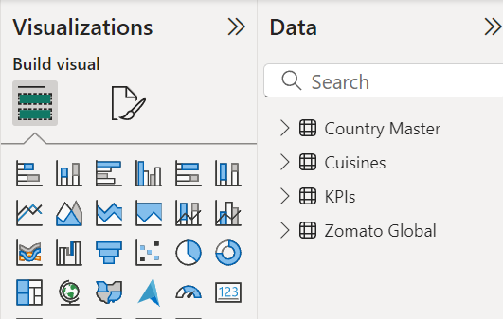
POWERBI DESKTOP

Slide 10
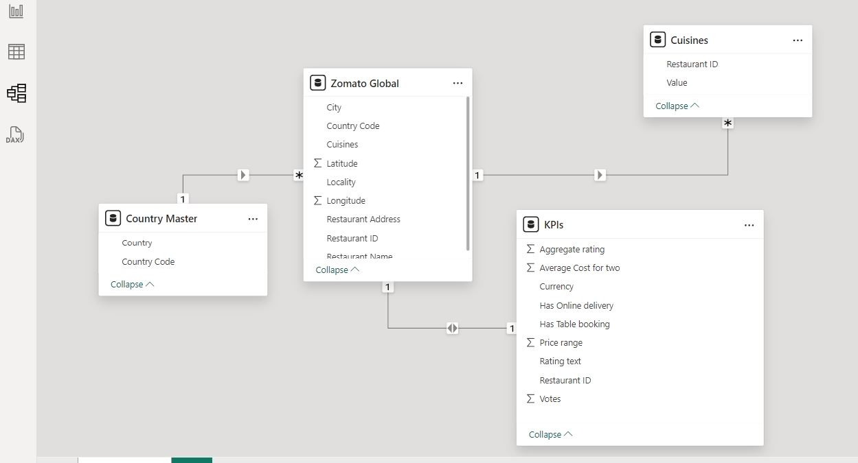
POWERBI DESKTOP – MODEL VIEW
- The model view helps to check relationships between tables

Slide 11
DAX Queries
Add a Rating color column in an appropriate table with the data rows in the format given below:
Rating Color =
IF(KPIs[Aggregate rating] > 4.5, "Dark Green", IF(KPIs[Aggregate rating] > 4, "Green",
IF(KPIs[Aggregate rating] > 3.5, "Yellow",
IF(KPIs[Aggregate rating] > 3, "Orange",
IF(KPIs[Aggregate rating] > 2.5, "Red",
IF(KPIs[Aggregate rating] > 0, "Dark Red", "Not Rated"))))))

Slide 12
DAX Queries
Restaurant Count
Average Cost
Average Rating
Cuisine Count

Slide 13
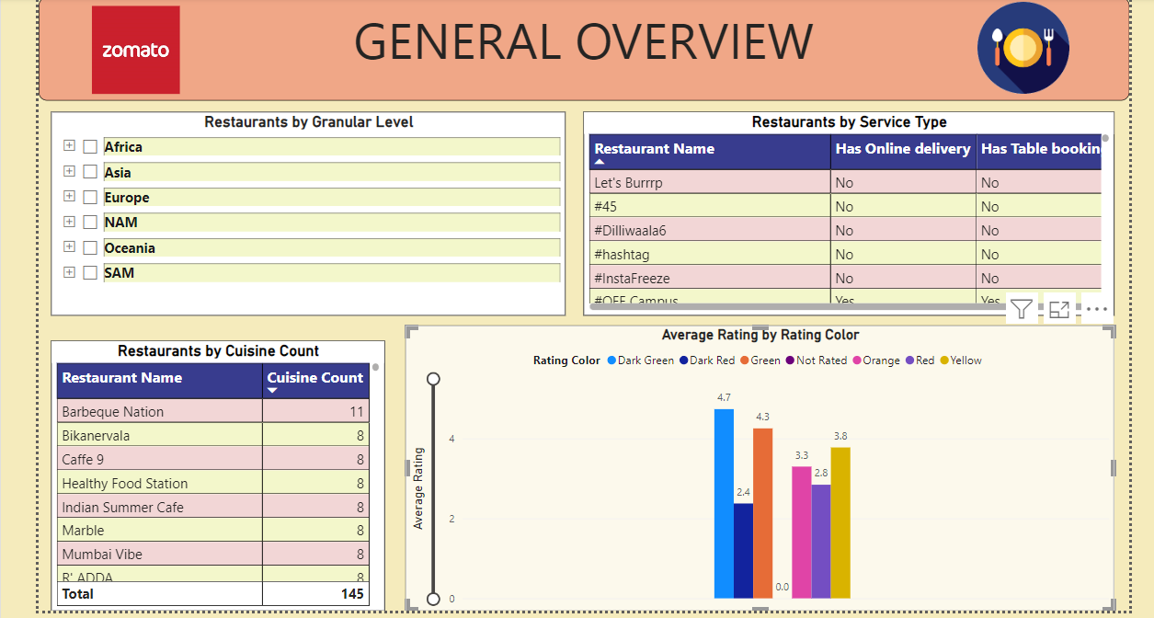
Visualizations in PowerBI – General Overview

Slide 14
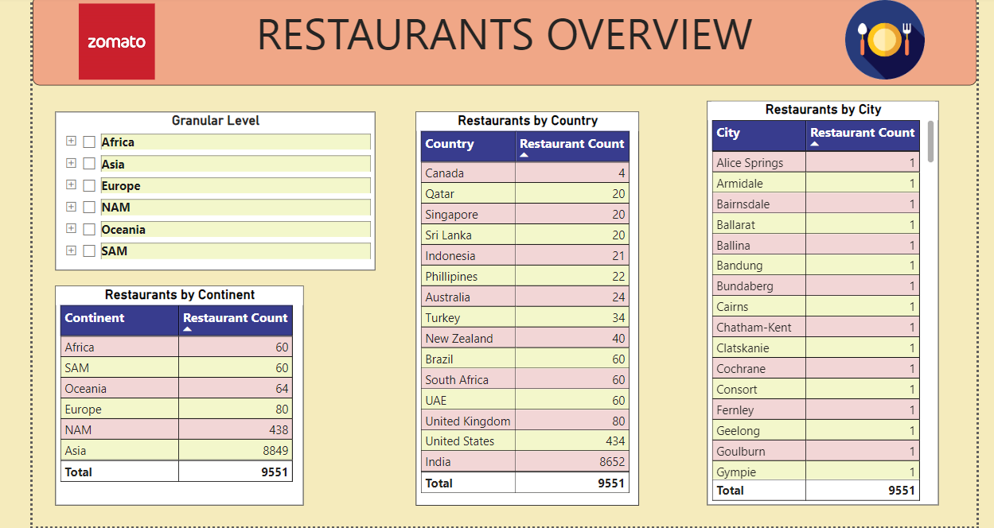
Visualizations in PowerBI – Restaurants Overview

Slide 15
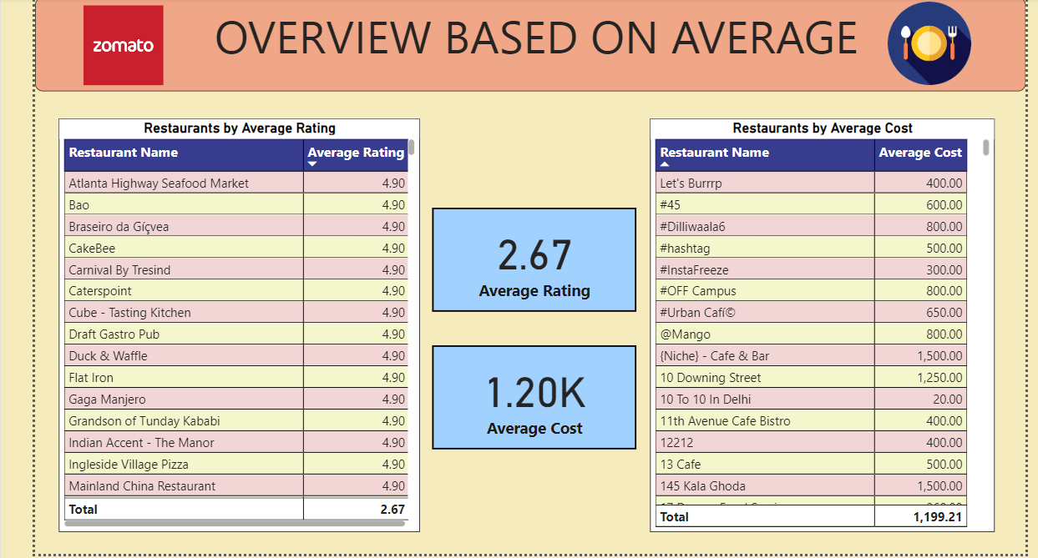
Visualizations in PowerBI – Overview based on Average

Slide 16




THANK YOU

